Slide 1


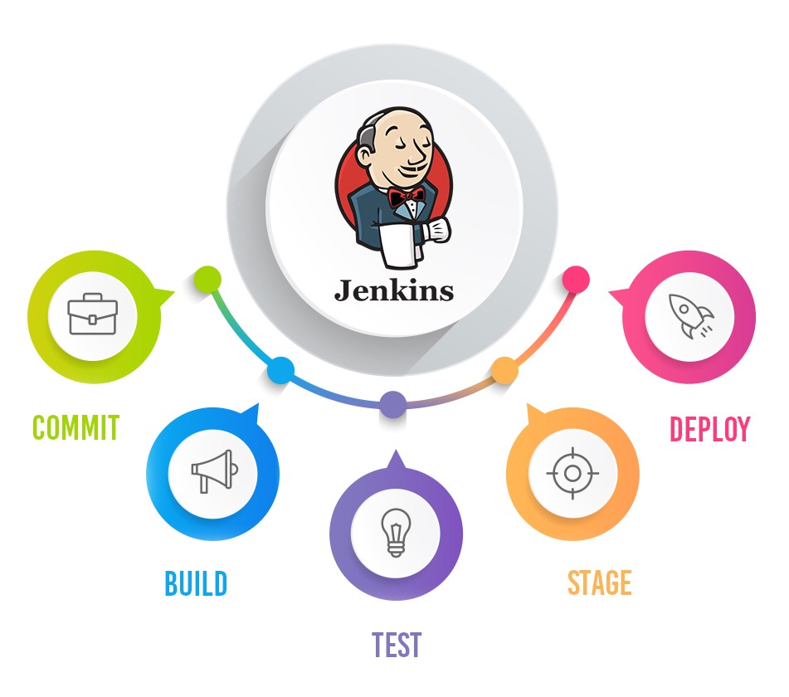
Jenkins Mastery for Software Tester
Pramod Dutta
Pipeline Job (Convert Freestyle to Pipeline)

Slide 2

What is Jenkins Pipeline?
Jenkins Pipeline (or simply "Pipeline" with a capital "P") is a suite of plugins which supports implementing and integrating continuous delivery pipelines into Jenkins.
The definition of a Jenkins Pipeline is written into a text file (called a Jenkinsfile) which in turn can be committed to a project’s source control repository

Slide 3
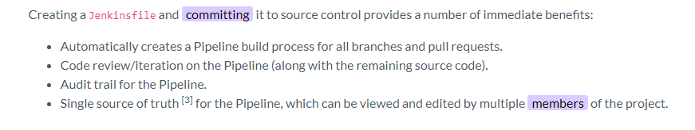
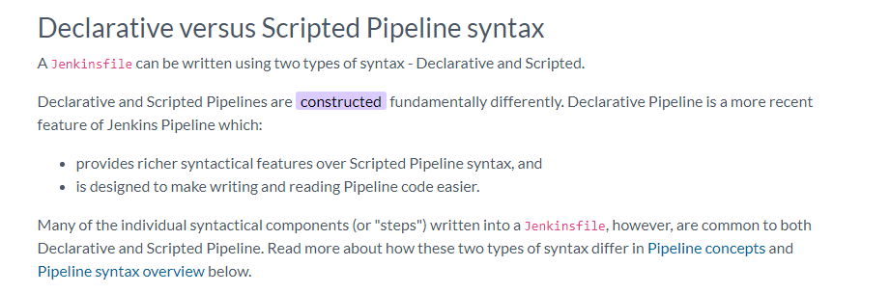
What is Jenkins Pipeline?

Slide 4
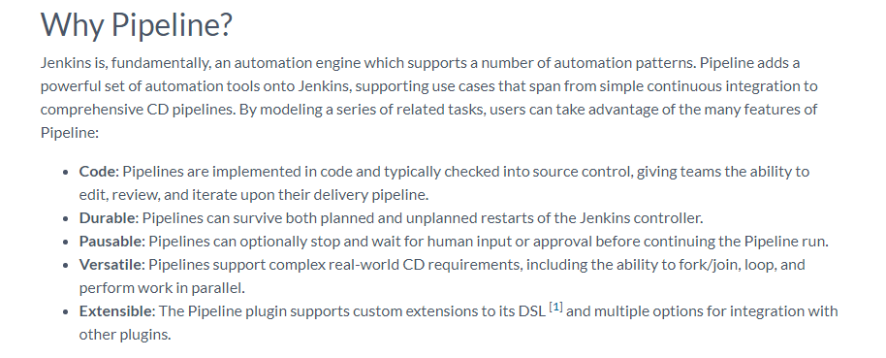

Slide 5
A Pipeline is a user-defined model of a CD pipeline

Slide 6
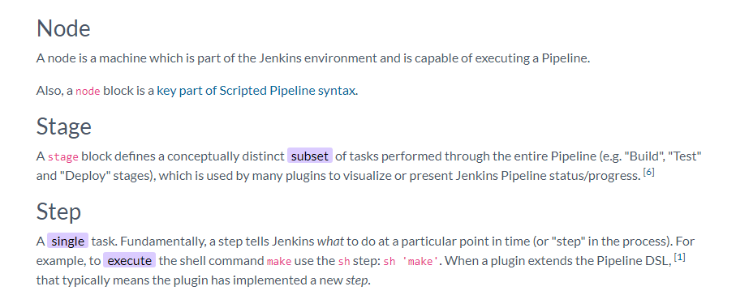

Slide 7
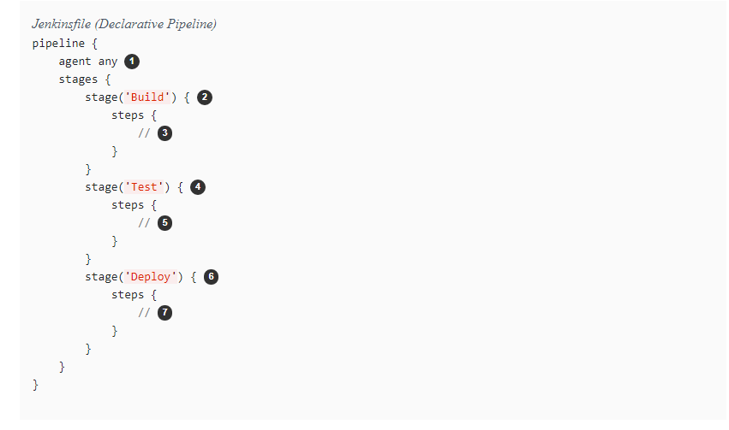

Slide 8
